Slide 1
Safety & Non-Operating Room Anesthesia
Risks and safety concerns of integrated anesthesia care outside of the operating room
Copyright © 2015 Mark S Weiss
All Rights Reserved

Slide 2
Why the concern for safety?
Anesthesia providers are now asked more frequently to provide complete, integrated anesthetic care outside the traditional OR setting.
The number and the complexity of such cases is increasing over time.
Specific logistical problems beyond typical anesthetic safety concerns:
Availability of preoperative patient assessment
Fewer resources, facilities often retrofitted for anesthesia care
Greater variation in physical set-ups and equipment
Decreased practitioner familiarity (environment, staff, organization)
Patient comorbidities unique to the particular specialty
Physical access to patient may vary
Shared airway
Availability of post-anesthesia monitoring/care
Copyright © 2015 Mark S Weiss
All Rights Reserved
Notes:
Over a ten year period (1998-2007) the number of NORA procedures doubled. Similar data have been reported by others. Adams et al. reported a quadrupling of the NORA activity in a pediatric hospital over a six year period.
Adams K, Pennock N, Phelps B, Rose W, Peters M. Anesthesia services outside of the operating room. Ped Nurs 2007;33:232- 7. 2.
Pino RM. The nature of anesthesia and procedural sedation outside the operating room. Curr Opin Anaesthesiol 2007;20:347-51.

Slide 3
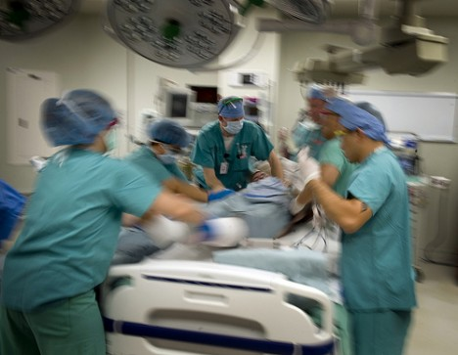
NORA Safety Issues
- Location -
Crowded rooms with limited access to the patient
Suboptimal light, insufficient power supplies
Distance from pharmacy / supply rooms
Availability of anesthesia staff/help if needed
Copyright © 2015 Mark S Weiss
All Rights Reserved

Slide 4
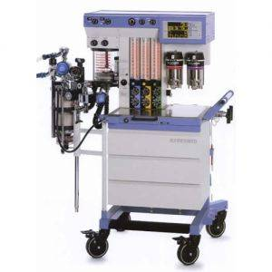
NORA Safety Issues
- Equipment -
Outdated/unfamiliar anesthesia machine
Availability of ETCO2 and other monitoring devices
Anesthesia provider responsible for all equipment checks
Availability of suction, oxygen
Availability of emergency airway equipment
Availability of emergency medications
Copyright © 2015 Mark S Weiss
All Rights Reserved

Slide 5
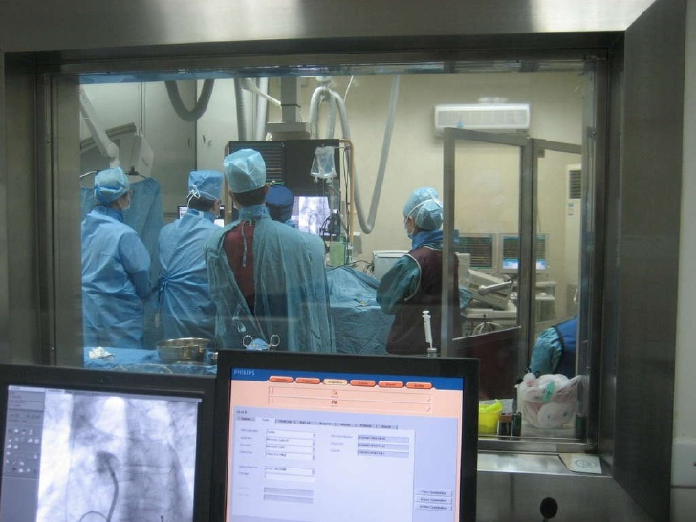
NORA Safety Issues
- Personnel / Support Staff -
On-site staff less familiar with the management of anesthetized patients
Personnel may even have limited medical background. (e.g. non-ACLS certified)
Communication & teamwork barriers, anesthesia provider as “outsider”
Less efficient or effective scheduling, resulting in inefficient or hurried patient preparation
Staff may not follow rigorous pre-procedure check-in processes
Copyright © 2015 Mark S Weiss
All Rights Reserved

Slide 6
NORA Safety Issues
- Patients -
Availability & depth of pre-procedure assessment
Ability of patient to cooperate (claustrophobia/anxiety/mental status)
Consent issues
Positioning (lateral/prone)
Comorbidities
Fasting status
Copyright © 2015 Mark S Weiss
All Rights Reserved

Slide 7
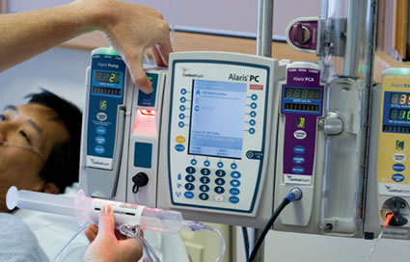
NORA Safety Issues
- Anesthetic Technique -
Sedation
Minimal
Moderate “conscious sedation”
Deep
General anesthesia
LMA vs. ETT
Considerations:
Patient comfort
Procedure requirements
Safety with unsecure airway
Copyright © 2015 Mark S Weiss
All Rights Reserved

Slide 8
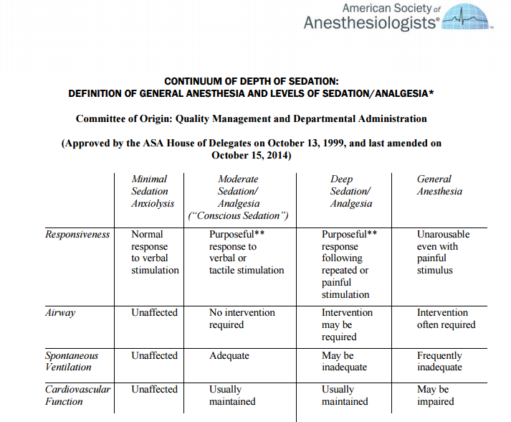
ASA Continuum of Sedation
Copyright © 2015 Mark S Weiss
All Rights Reserved

Slide 9
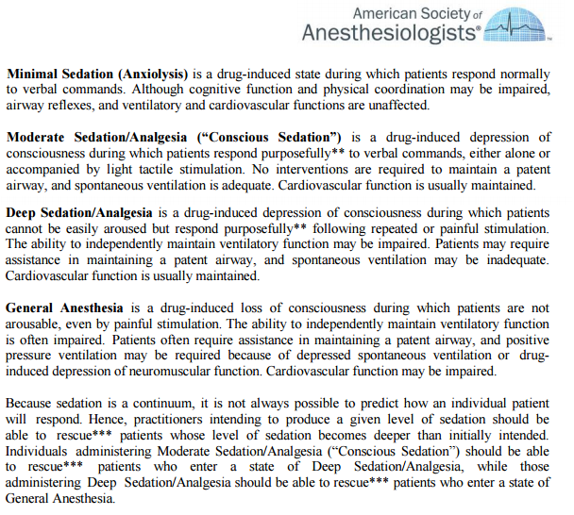
ASA Continuum of Sedation - cont
Copyright © 2015 Mark S Weiss
All Rights Reserved

Slide 10
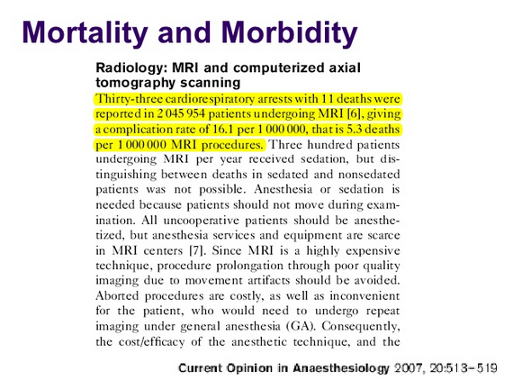
When things go wrong…
Copyright © 2015 Mark S Weiss
All Rights Reserved

Slide 11
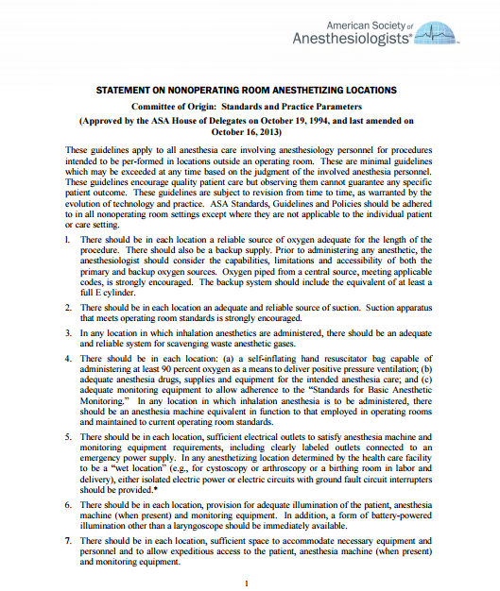
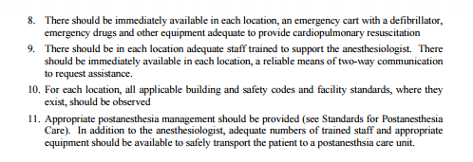
Statement on NORA locations
Copyright © 2015 Mark S Weiss
All Rights Reserved

Slide 12
Morbidity & Mortality in NORA
M&M data related to NORA infrequently studied and poorly described
Robbertze R, Posner KL, Domino KB. Closed claims review of anesthesia for procedures outside the operating room. Curr Opin Anaesthesiol 2006;19:436-42.
Mortality increased with NORA as opposed to conventional operating room anesthesia
Substandard care more prominent in NORA, many complications could have been prevented with better monitoring
NORA claims were mostly associated with monitored anesthesia care and with extremes of age
Copyright © 2015 Mark S Weiss
All Rights Reserved

Slide 13
Morbidity & Mortality in NORA
M&M data related to NORA infrequently studied and poorly described
Cravero JP, et al. and the Pediatric Sedation Consortium. Incidence and nature of adverse events during pediatric sedation/anesthesia for procedures outside the operating room: report from the pediatric sedation research consortium. Pediatrics 2006;118:1087-96.
Reported the incidence and nature of adverse events occurring in NORA in over 30 000 pediatric patients.
No deaths occurred. Cardiopulmonary resuscitation required once.
Most prominent type of complication was respiratory related.
Once per 89 NORA procedures resulted in an event which could have been potentially harmful if timely rescue was not performed.
Similar results previously described by Malviya and Pino (1997, 2000)
Copyright © 2015 Mark S Weiss
All Rights Reserved
Notes:
Malviya S, Voepel-Lewis T, Tait AR. Adverse events and risk factors associated with the sedation of children by nonanesthesiologists. Anesth Analg 1997;85:1207-13.
Malviya S, Voepel-Lewis T, Eldevik OP, Rockwell DT, Wong JH, Tait AR. Sedation and general anaesthesia in children undergoing MRI and CT: adverse events and outcomes. Brit J Anaesth 2000;84:743-8.

Slide 14
How can we improve safety?
Goal = improve the reliability of achieving a safe NORA anesthetic
Consistent success in NORA, as in the operating room, may be achieved by adhering to structural and organizational standards
Need for evaluation & analysis of the processes/steps required process of each type of NORA anesthetic
The reliability of each step (whether each step occurs as it should) determines whether the a particular algorithm/protocol is reproducible
Protocol safety and overall reliability also determined by the rate of defects in each step
Copyright © 2015 Mark S Weiss
All Rights Reserved

Slide 15
How can we improve safety?
Frankel A. Patient Safety: Anesthesia in Remote. Anesthesiology Clinics, 27(1): 127 – 139.
Identified major factors that contribute to the ability to ensure reliable and safe practices in NORA
An environment of continuous learning
A just and fair culture
An environment of enthusiasm for teamwork
Leaders engaged in safety and reliability through the use of data
Effective flow of information
Copyright © 2015 Mark S Weiss
All Rights Reserved

Slide 16
Tools & Targets for Improving Safety
Organizational tools
Quality improvement methods
Protocols
Checklists
Communication during the procedure and during transfer of patient care
Continuing education
Copyright © 2015 Mark S Weiss
All Rights Reserved

Slide 17
Standardization & Anesthesia Safety
Eichhorn JH, Cooper JB, Cullen DJ, et al: Standards for patient monitoring during anesthesia at Harvard Medical School . JAMA 1986;256:1017-1020
The Harvard Anesthesia Practice Standards written in the 1980s
Example of the standardization of anesthesia care that has helped improve the safety of the specialty
Identified minimum monitoring expectations now commonly used in every anesthetic procedure
Influenced widespread adoption of pulse oximetry and capnography
Copyright © 2015 Mark S Weiss
All Rights Reserved

Slide 18
Quality Improvement
Even though effective organizations take steps to prevent adverse incidents, problematic events still occur.
It is vital to have a defined approach to reacting to adverse events, including errors and near-misses.
Proactive vs. reactive approach
Copyright © 2015 Mark S Weiss
All Rights Reserved

Slide 19
Protocols & Checklists
Haynes AB, Weiser TG, Berry WR, et al. A surgical safety checklist to reduce morbidity and mortality in a global population. N Engl J Med 2009;360:491-9.
Copyright © 2015 Mark S Weiss
All Rights Reserved

Slide 20
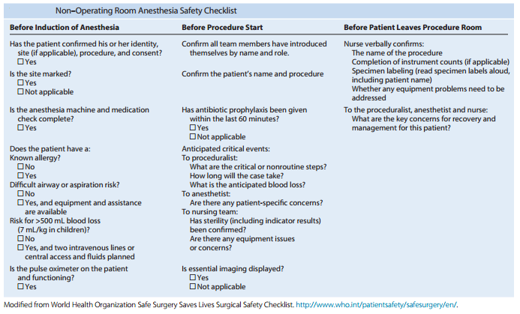
Protocols & Checklists, cont’d
Copyright © 2015 Mark S Weiss
All Rights Reserved

