Slide 1
Chaplains’ Work with Trauma
Patients and Their Families
Chaplain John Ehman
9/21/17

Slide 2
This presentation will focus on working with patients and families at a hospital after a significant blunt or penetrating injury (for example: falls, gunshot or stab wounds, assaults, motor vehicle collisions and pedestrian impacts) or a burn injury.
Such trauma patients tend to be initially unavailable to a chaplain, because they are involved in medical assessment/treatment or are unconscious or incoherent. Therefore, chaplains often work first with families who have only just learned of the injury.

Slide 3
TRAUMA
• Etymology: from the Greek (τραῦμα / τρῶμα) for wound.
• Working Definition #1: A trauma is a serious physical injury
or psychological experience that overwhelms our capacity
to cope, not only evoking an acute reaction but indelibly
affecting our being and sense of well-being.
• Working Definition #2: An instantly life-changing event for
a patient/family, requiring immediate trust in an unfamiliar
medical team in a moment when the world feels particularly
uncertain and unsafe.
• Practical Emphasis for This Presentation: hours to days
after the traumatic event

Slide 4
Psychosocial Hallmarks of Trauma
in the Hours/Days after the Event
• Acute stress reaction (early on, often more of a practical
issue for chaplains working with families than with patients)
• Strong tendency to identify cause …and blame
• Potential for utterly shattering the sense of one’s world
and the struggle for meaning-making in sudden loss
• Seeds of Post-Traumatic Stress Disorder (PTSD)
and/or Post Traumatic Growth (PTG)

Slide 5
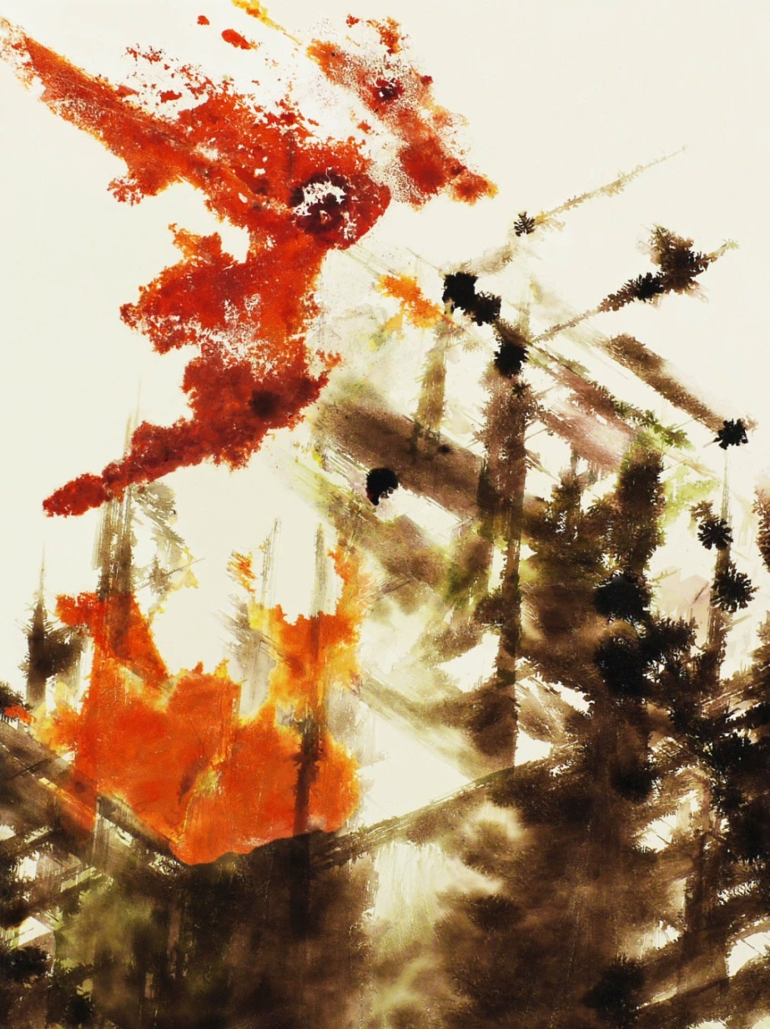
“Cataclysm”
By John Ehman

Slide 6
Acute Stress Reaction and Pastoral Response

Slide 7
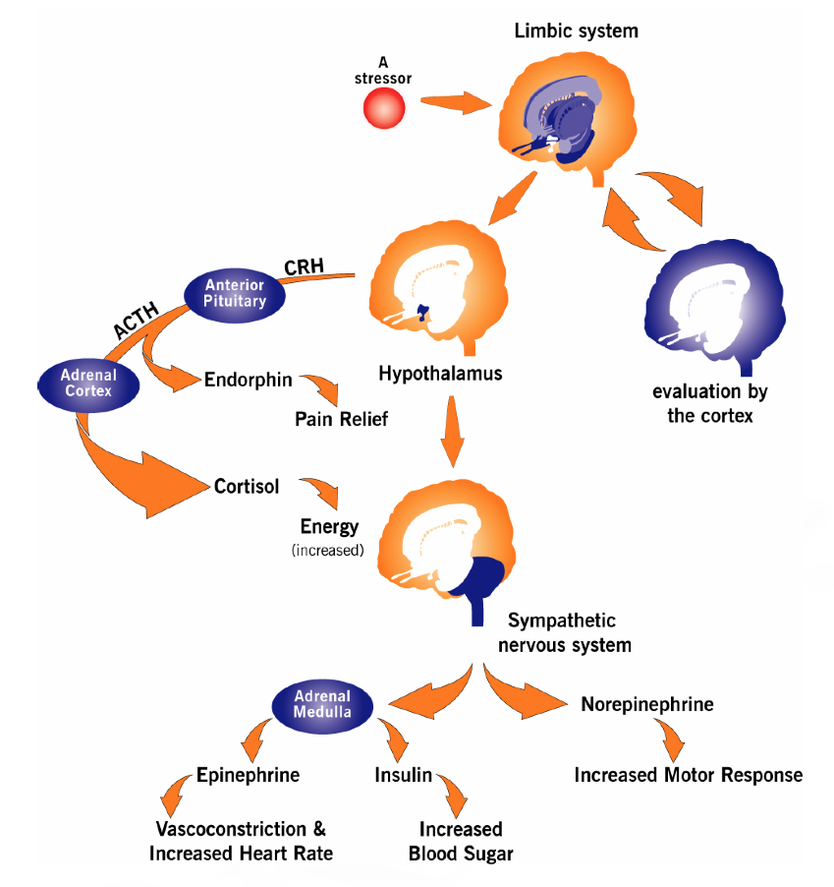
Acute Stress
Reaction
“Fight or Flight”
Blood (and Sugar) to Muscles and away
from Stomach
Sudden Change
in Heart Rate
Hyperventilation
and/or Fainting
Over-activity / Agitation
or Withdrawal /“Daze”
Narrowed Attention
Intrusive Rumination
Impaired Memory
and Comprehension
Strong, Labile Emotions
Heightened
Sense of Threat
—graphic: Agency for Toxic Substances and Disease Registry, 2005

Slide 8
Paying attention to the physiological dynamics
of an acute stress reaction is one way of
staying both objective and empathetic
toward a patient or family
…and to keep from being objectifying,
which leaves no room for empathy

Slide 9
What challenge does an acute stress reaction
present to a model of patient-led pastoral care?
People experiencing acute stress reactions have reduced capacity to take a constructive lead in pastoral interactions. This may require the chaplain to take more of a lead than normal until the reaction subsides, while always working to maximize the opportunity for patient-led pastoral care by seeking to empower the patient or family member. However, while some people in acute stress reactions may be passive and suggestible, others may interpret a chaplain’s initiative as “pushy”; and families may have a mix of these responses, requiring a balancing and modulation of pastoral outreach.

Slide 10
Basic Needs During an Acute Stress Reaction
• Normalization (i.e., manageability) of the extraordinary situation
• Control of events; exertion of purpose
• Information
• Reduced stimuli (--and reduced pressure for cognitive processing)
• Space
• Sense of connection with others
• Hopefulness

Slide 11
Basic Needs During an Acute Stress Reaction
• Normalization (i.e., manageability) of the extraordinary situation
• Control of events; exertion of purpose
• Information
• Reduced stimuli (--and reduced pressure for cognitive processing)
• Space
• Sense of connection with others
• Hopefulness
How might chaplains help with these needs?

Slide 12
Basic Needs During an Acute Stress Reaction
• Normalization (i.e., manageability) of the extraordinary situation
- Calmly name what is happening; orient people to processes and timing
• Control of events; exertion of purpose
• Information
• Reduced stimuli (--and reduced pressure for cognitive processing)
• Space
• Sense of connection with others
• Hopefulness
How might chaplains help with these needs?

Slide 13
Basic Needs During an Acute Stress Reaction
• Normalization (i.e., manageability) of the extraordinary situation
- Calmly name what is happening; orient people to processes and timing
• Control of events; exertion of purpose
- Allow the other to lead as much as feasible; show role of helper/advocate
• Information
• Reduced stimuli (--and reduced pressure for cognitive processing)
• Space
• Sense of connection with others
• Hopefulness
How might chaplains help with these needs?

Slide 14
Basic Needs During an Acute Stress Reaction
• Normalization (i.e., manageability) of the extraordinary situation
- Calmly name what is happening; orient people to processes and timing
• Control of events; exertion of purpose
- Allow the other to lead as much as feasible; show role of helper/advocate
• Information
- Listen actively; respond to questions; convey information quickly/clearly
• Reduced stimuli (--and reduced pressure for cognitive processing)
• Space
• Sense of connection with others
• Hopefulness
How might chaplains help with these needs?

Slide 15
Basic Needs During an Acute Stress Reaction
• Normalization (i.e., manageability) of the extraordinary situation
- Calmly name what is happening; orient people to processes and timing
• Control of events; exertion of purpose
- Allow the other to lead as much as feasible; show role of helper/advocate
• Information
- Listen actively; respond to questions; convey information quickly/clearly
• Reduced stimuli (--and reduced pressure for cognitive processing)
- Reduce extraneous noise/activity; buffer decision-making pressure
• Space
• Sense of connection with others
• Hopefulness
How might chaplains help with these needs?

Slide 16
Basic Needs During an Acute Stress Reaction
• Normalization (i.e., manageability) of the extraordinary situation
- Calmly name what is happening; orient people to processes and timing
• Control of events; exertion of purpose
- Allow the other to lead as much as feasible; show role of helper/advocate
• Information
- Listen actively; respond to questions; convey information quickly/clearly
• Reduced stimuli (--and reduced pressure for cognitive processing)
- Reduce extraneous noise/activity; buffer decision-making pressure
• Space
- Avoid “trapped” space; give “own” space, esp. for emotional expression
• Sense of connection with others
• Hopefulness
How might chaplains help with these needs?

Slide 17
Basic Needs During an Acute Stress Reaction
• Normalization (i.e., manageability) of the extraordinary situation
- Calmly name what is happening; orient people to processes and timing
• Control of events; exertion of purpose
- Allow the other to lead as much as feasible; show role of helper/advocate
• Information
- Listen actively; respond to questions; convey information quickly/clearly
• Reduced stimuli (--and reduced pressure for cognitive processing)
- Reduce extraneous noise/activity; buffer decision-making pressure
• Space
- Avoid “trapped” space; give “own” space, esp. for emotional expression
• Sense of connection with others
- Use the family’s own support system; facilitate getting people together
• Hopefulness
How might chaplains help with these needs?

Slide 18
Basic Needs During an Acute Stress Reaction
• Normalization (i.e., manageability) of the extraordinary situation
- Calmly name what is happening; orient people to processes and timing
• Control of events; exertion of purpose
- Allow the other to lead as much as feasible; show role of helper/advocate
• Information
- Listen actively; respond to questions; convey information quickly/clearly
• Reduced stimuli (--and reduced pressure for cognitive processing)
- Reduce extraneous noise/activity; buffer decision-making pressure
• Space
- Avoid “trapped” space; give “own” space, esp. for emotional expression
• Sense of connection with others
- Use the family’s own support system; facilitate getting people together
• Hopefulness
- Be attentive to “brittle” hope (i.e., wishing for highly specific things)
How might chaplains help with these needs?

Slide 19
S.O.L.E.R.: A Strategy for Presence
Originally proposed by psychologist Gerard Egan as a way to “make sure you are physically present to a client,” the S.O.L.E.R. strategy has been widely adopted by emergency responders and crisis counselors.
S: sit facing the person --at an angle may be preferred
O: have an open posture (with no crossed arms or legs)
L: slightly lean in toward the person (though not aggressively)
E: make eye contact (where this is not culturally contraindicated)
R: be relaxed, non-anxious
See: Stickley, T., “From SOLER to SURETY for effective non-verbal communication,” Nurse Education in Practice 11, no. 6 (Nov 2011): 395-398; and Egan, G., The Skilled Helper, 1975.

Slide 20
What are the dynamics around physical touch?
In addition to normal cultural and interpersonal dynamics, a chaplain’s touch during an acute stress reaction could potentially play into a person’s heightened sense of threat. In the context of a family system, some people may even see a chaplain’s touch of another family member as threatening to family roles. Chaplains should try to utilize the immediate support resources within a family system as much as possible -- e.g., family members’ roles for caretaking of others -- and consider taking cues from family leaders regarding physical touch.

Slide 21
Working with/through the family’s own system
for order and care:
• Identify key family authorities and managers
(--including information managers).
• Feel free to ask for the help of key family members
in caring for particularly needful individuals and in
managing the family as a whole.
• Family members’ roles tend to be resilient. (Acting in an
established family role during a crisis is a way of coping
with an acute stress reaction.)
• Imagine the family system’s response as somewhat
analogous to an “immune system” response to an
injury to the “body” of the family.

Slide 22
How might a religious role of the chaplain
play into basic needs of the family/patient
during an acute stress reaction situation?

Slide 23
Some Aspects of the Religious Role of a Chaplain
Explicit Engagement and Honoring of Patient/Family Spirituality
Professional Connection to Community Clergy
Religious “Authority”
Representing the Presence of God
Wisdom/Experience of “Clergy” in Extraordinary Situations
Ritual Leadership (especially prayer)
Pastoral Ethic of Caring and Trustworthiness

Slide 24
Some Aspects of the Religious Role of a Chaplain
Explicit Engagement and Honoring of Patient/Family Spirituality
Professional Connection to Community Clergy
Religious “Authority”
Representing the Presence of God
Wisdom/Experience of “Clergy” in Extraordinary Situations
Ritual Leadership (especially prayer)
Pastoral Ethic of Caring and Trustworthiness
…but the religious role may be insignificant or even
dysfunctional if people aren’t able or willing to accept it

Slide 25
A Note about Safety-Based Needs
• Be prepared for falls and collapses; avoid cluttered spaces
• Reduce the presence of sharp, breakable, or throw-able objects
• Be attentive to warning signs of medical crises (e.g., cardiac, diabetic)
• Be attentive to effects of alcohol/drugs

Slide 26
A Note about Safety-Based Needs
• Be prepared for falls and collapses; avoid cluttered spaces
• Reduce the presence of sharp, breakable, or throw-able objects
• Be attentive to warning signs of medical crises (e.g., cardiac, diabetic)
• Be attentive to effects of alcohol/drugs
• For the chaplain, personally:
- prepare for how to avoid trapped space
- have a measured plan for response to physical threat or medical crisis
- help other responders to gain perspective on what is happening
- be prepared for anger, and be mindful to de-escalate tensions

Slide 27
A Note about Safety-Based Needs
• Be prepared for falls and collapses; avoid cluttered spaces
• Reduce the presence of sharp, breakable, or throw-able objects
• Be attentive to warning signs of medical crises (e.g., cardiac, diabetic)
• Be attentive to effects of alcohol/drugs
• For the chaplain, personally:
- prepare for how to avoid trapped space
- have a measured plan for response to physical threat or medical crisis
- help other responders to gain perspective on what is happening
- be prepared for anger, and be mindful to de-escalate tensions
(seek to minimize a need to compromise your non-anxious presence)

Slide 28
How might you – the chaplain – minimize your own
acute stress reaction?
• Pay attention to cues from your own body, and
acknowledge a need to break the stress cycle.
• When you feel “out on a limb,” remember that
you are part of a team.
• Look for small opportunities to “catch your breath”
and refocus on the situation.
• Make intentional use of “down time” between
events to relax, refocus, and debrief (--you are
more susceptible to an acute stress reaction if
you are tired, “wired,” or in need of food/water).

Slide 29
Challenge for the Chaplain During a Trauma Response
Keeping
Objective
Perspective
as Part of a
Professional
Care Team
Offering Emotional
Engagement as Vital to
Pastoral Practice
Managing
One’s Own Personal
Stress Reaction to
the Situation
⬄
⬄

Slide 30
“Light in a Fractured World”
By John Ehman

Slide 31
In the Special Case of a Patient’s Death
Soon after Hospitalization
There is a limited opportunity for the chaplain to make an impact on the family’s subsequent journey of healing, by taking advantage of last interactions with family members.

Slide 32
“Sowing Seeds for Healing” in the Grieving Family
• Express sorrow specifically for the loss (as opposed to an open-ended
statement of “I’m sorry”). Speak eye-level to eye-level and, unless
contraindicated, let the family know that you’ll keep them and their
loved one in your thoughts/prayers that night. Look for opportunities
to make small gestures of compassion, as families in shock may
not remember what has been said as much as what has been done.
• Encourage the family to talk about their loss in the days ahead, but
acknowledge that everyone in the family will be moving through
grief in their own way, and some people outside of the family may
have a hard time hearing and understand their traumatic feelings.
(This may be a specific message for the family member who
appears to be taking the lead in overseeing the family’s needs.)
• Plant the idea of a bereavement support group or formal counseling.
State that many people find this helpful.
• If practical, walk the family to the door. Let them leave you instead
of you leaving them. Be receptive to the family’s hugs.

Slide 33
Strong Tendency to Identify Cause …and Blame

Slide 34
Attribution of Cause/Blame in Trauma
• Easy for people to “connect the dots” regarding the trauma,
resulting in taking responsibility or attributing responsibility
• A meaning-making/coping response that simplifies the sense
of overwhelming chaos and pain
• Blame may be re-directed when an identified cause is
unacceptable (e.g., self, sacrosanct family member, God)
• The Care Team members may be available options for
blame unless perceived as the patient’s champions
• Caregivers should avoid taking sides in a blame game,
and continually emphasize a focus on the care and dignity
of the patient

Slide 35
Attributions of Responsibility
Research into the blaming of self or others after traumatic events has produced mixed findings but suggests that attributions of responsibility are complex and may potentially affect health outcomes.
If attributions of responsibility involve a person’s religious beliefs (e.g., “God is testing me” or “the devil did this to me”), they play into the particular dynamic of religious coping and may signal spiritual distress.

Slide 36
Shattering the Sense of One’s World

Slide 37
An Overwhelming Sense of Loss
In trauma, immediate loss and anticipatory loss (usually rooted in past loss) flood together and can overwhelm a sense of perspective. One’s entire world may feel utterly shattered, in the present moment, which can seem unmoored from what has given life order and meaning.
In such a time, how might we regain the moorings of order and meaning for our lives? How might we find our way to feeling more than just loss and chaos?

Slide 38
Maintaining / Regaining a Sense of Meaning after Trauma
A classic model of coping after trauma turns on the alignment or realignment of one’s interpretation of a traumatic event with one’s larger worldview.
Some research suggests that religious beliefs, as a part of a person’s religious life, can be an especially strong factor in maintaining or regaining congruence between an understanding of a trauma and a sense of global meaning.

Slide 39
Basic Model of Coping with Traumatic Stressors
Worldview Assumptions
/ Beliefs

Slide 40
Basic Model of Coping with Traumatic Stressors
Worldview Assumptions
/ Beliefs
Traumatic Stressor

Slide 41
Basic Model of Coping with Traumatic Stressors
Worldview Assumptions
/ Beliefs
Traumatic Stressor
Appraised Meaning of
the Stressor

Slide 42
Basic Model of Coping with Traumatic Stressors
Worldview Assumptions
/ Beliefs
Discrepancy?
Traumatic Stressor
Appraised Meaning of
the Stressor

Slide 43
Basic Model of Coping with Traumatic Stressors
Coping may involve a change in Worldview Assumptions /Beliefs and/or reappraisal of the Stressor
Worldview Assumptions
/ Beliefs
Discrepancy?
Traumatic Stressor
Appraised Meaning of
the Stressor

Slide 44
Basic Model of Coping with Traumatic Stressors
Coping may involve a change in Worldview Assumptions /Beliefs and/or reappraisal of the Stressor
Worldview Assumptions
/ Beliefs
Discrepancy?
Traumatic Stressor
Appraised Meaning of
the Stressor

Slide 45
An Augmented Model of Coping with Traumatic Stressors
Zukerman, G. and Korn, L., “Post-Traumatic Stress and World Assumptions: The Effects
of Religious Coping,” Journal of Religion and Health 53, no. 6 (Dec 2014): 1676-1690
Coping may involve a change in Worldview Assumptions /Beliefs and/or reappraisal of the Stressor
Worldview Assumptions
/ Beliefs
Discrepancy?
Religious Beliefs
Traumatic Stressor
Appraised Meaning of
the Stressor

Slide 46
The Seeds of Post-Traumatic Stress Disorder
and Post-Traumatic Growth for the Patient

Slide 47
Common After-Effects of Trauma
• Intrusive thoughts, including flashbacks to the traumatic event
• Desire to avoid people or conversations (esp. re: the event)
• Emotionally numb or emotionally overwhelmed at various times
• Negative mood; negative feelings toward self and/or others
• On edge; sensitive to little things as irritating or threatening
• Trouble concentrating of sleeping (including nightmares)

Slide 48
Responding to Patients to Encourage
Psychosocial Health
1) Listen attentively, actively, responsively.
2) Acknowledge – generally, without taking a position
on a patient’s questions/conclusions – statements
of meaning-making and relationship.
3) Affirm how a traumatic event is an emotional event,
which can hit us in waves of feeling overwhelmed.
4) Encourage the patient not to be alone in thinking
about what’s happened but rather to think things
through with trained counselors, support groups,
or at least trusted friends (–though not all friends
will know how to be helpful).

Slide 49
Post-Traumatic Growth (PTG)
The idea of PTG is that many people can recognize experiences of personal “growth” emerging from a traumatic incident, even while suffering such negative effects as Post-Traumatic Stress Disorder.
Research on PTG has focused on themes of:
• a greater appreciation for life in general
• a more enriching sense of relationships
• an awareness of one’s own strengths
• the perception of new possibilities
• a deepening sense of spirituality

Slide 50
Post-Traumatic Growth (PTG)
The idea of PTG is that many people can recognize experiences of personal “growth” emerging from a traumatic incident, even while suffering such negative effects as Post-Traumatic Stress Disorder.
Research on PTG has focused on themes of:
• a greater appreciation for life in general
• a more enriching sense of relationships
• an awareness of one’s own strengths
• the perception of new possibilities
• a deepening sense of spirituality
Chaplains can acknowledge “growth” …but never at the
expense of acknowledging the deep injury of trauma.

Slide 51
“Horizon”
By John Ehman

Slide 52
Postscriptum
Chaplains’ Experience and Self-Care:
Contending with Secondary Traumatic Stress (STS)
and Vicarious Traumatization

Slide 53
Chaplains and
Secondary Traumatic Stress / Vicarious Traumatization
When we engage sufferers of trauma at an emotional and empathic level, we can become susceptible to the effects of traumatic experience. This often occurs after repeated exposures over time, but the process can be exacerbated by our particular sensitivities from our own stories.

Slide 54
Chaplains and
Secondary Traumatic Stress / Vicarious Traumatization
When we engage sufferers of trauma at an emotional and empathic level, we can become susceptible to the effects of traumatic experience. This often occurs after repeated exposures over time, but the process can be exacerbated by our particular sensitivities from our own stories.
Warning signs include:
• avoidance of topics or situations with patients
• difficulty empathizing or feeling compassion
• trouble attending to proper boundaries
• lack of interest in work / “going through the motions”
• sense of cynicism or disillusionment
• PTSD-like symptoms (for example: flashbacks)

Slide 55
Professional caregivers’ responsibility to stay whole and able for those who look to us for help.
• Self-care as a personal discipline
(including attention to support from others)
• Intentional use of professional experiences
to advance one’s capacity for caregiving
• Idea of vicarious resilience

Slide 56
john.ehman@uphs.upenn.edu

