Slide 1
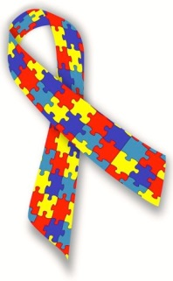
Spectrum of Care: Engaging in chaplaincy with individuals who have autism
Margaret Lynn B. Kobb, MDiv
Staff Chaplain
Hospital of the University of Pennsylvania

Slide 2
Objectives
What is autism?
Vocabulary of the spectrum
Experience of patients on the Autism Spectrum
Experience of family members
Theology of disability
Practical approaches in pastoral care
Case studies
Discussion & questions

Slide 3
Why it matters to me
Chaplain, advocate, MOM
Being an Autism Mom makes me better at the other two
Work locally & nationally with Autism Speaks
Blessed to be a blessing

Slide 4
What is autism?

Slide 5
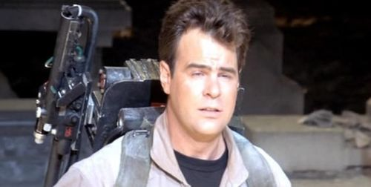
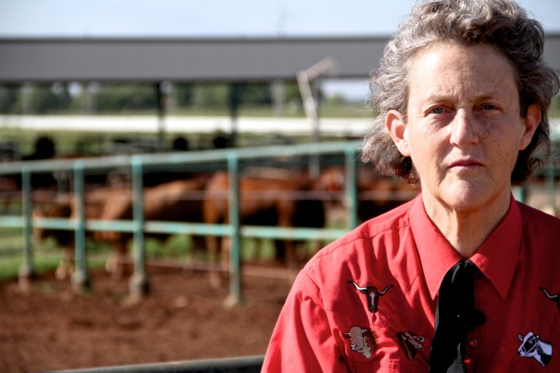
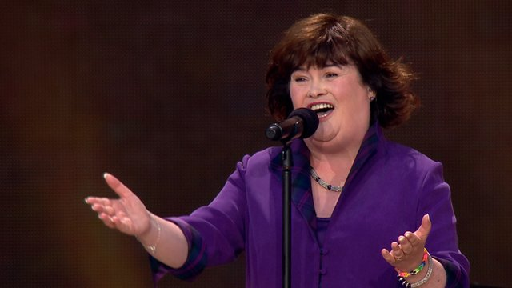
Autism in the world

Slide 6
What is autism?
Autism is a neurological disorder characterized by deficits in both language and communication.

Slide 7
Autism Spectrum Disorder
DSM-5
Classic Autism Asperger’s Disorder
High-Functioning Autism Atypical Asperger’s
PDD-NOS (Pervasive Developmental Disorder-Not Otherwise Specified)
Childhood Disintegrative Disorder
Sensory Processing Disorder Rett’s Disorder

Slide 8
DSM-5: Autism Spectrum Disorder
Persistent deficits in social communication and social interaction
Restricted, repetitive patters of behavior, interests, or activities
Symptoms are present in early childhood
Symptoms limit or impair everyday functioning or relationships
(Tierney, 2015)

Slide 9
Common Behaviors in ASD
Decreased eye contact
Uneven development of skills
Resistance to changes in routine
Marked hyperactivity and/or extreme passivity, which may alternate
Less demonstration of typical signs of affection
Odd body movements or postures (flapping, spinning, etc.)
(Challman, 2015)

Slide 10
So what does that look like?
Looking down, instead of at you when you speak
Not answering questions, or not answering right away
Not wanting to be touched
Repetitive rocking, swaying or bouncing
Walking only on toes
Flapping hands
Making noises that are not words

Slide 11
Sensory Sensitive
Frequently, people on the Autism Spectrum experience sensory input more acutely.
Increased sensitivity to heat/cold, light/dark, textures on clothing or surfaces, sound—especially loud noises, textures in foods, strong smells
Easily overwhelmed or distracted

Slide 12
Sensory Overload
https://vimeo.com/103896616

Slide 13
Causes of Autism
VACCINES
DO NOT
CAUSE AUTISM.

Slide 14
The persistent vaccine myth
Dr. Andrew Wakefield published a paper in 1998 claiming that the MMR vaccine had caused autism in the children in his study.
Sample size = 12
Never replicated
Falsified data
Soundly rebuked by the medical community
And yet the damage was done.

Slide 15
So then what does?
Genetic
Environmental
Gene deletion or mutation
About a dozen genes where deletion is involved
About two dozen genes were mutation is involved
All environmental influences happen in utero:
Certain maternal infections
Certain toxic exposures (often alcohol)
Risk elevated with prematurity

Slide 16
A growing population
CDC: 1 in 68 children will be diagnosed with autism
Recent government survey has even higher numbers…1 in 45.
2% of the population

Slide 17
Vocabulary for the spectrum

Slide 18
Our words matter!
Person-centered language:
“patient with autism”
not “autistic patient”
“On the spectrum”
“Aspie” as a self-identifier for many

Slide 19
“Normal”
“Normal” implies that there is an “abnormal.”
Better choice:
neuro-typical
Never use “retarded.”
Better choice:
developmentally disabled

Slide 20
Experiences of patients on the autism spectrum

Slide 21
Patient Experiences

Slide 22
Patient Experiences
OVERWHELMING!
Strangers all around
They’re touching
They’re talking
Bright lights
Siren outside
So many needles

Slide 23
Patient Experiences
Change in routine
Different bed
Different food
Unfamiliar noises
And all of this while you’re not feeling well
Unsettled & anxious

Slide 24
The challenge of non-verbal patients
1/3 of children and adults with autism are non-verbal.
(Autism Speaks)
How do you know if your patient is in pain?
How do you know if your patient wants to visit?
How do you engage in spiritual care with someone with social and language impairments?

Slide 25
Yearning to connect
“Without fail, parents believed at least one of three things about their children’s spiritual lives: that their children had a deep spiritual connection to God; that they had the capacity to develop such a relationship; or that through their active involvement and visible presence in the church community, they could enhance the spiritual lives of the members.”
(Speraw, 2006)

Slide 26
A Vibrant Spiritual Life
“We often don’t give adolescents, especially those with special needs, enough credit when it comes to spirituality. Because an adolescent has a physical, neurological, or intellectual disability, and can’t communicate in our way, we assume a lack of depth or sophistication. A disability, however, does not mean there are limitations in the ability to have a spiritual life.”
(Spitzer, 2008)

Slide 27
“A” and her prayer life

Slide 28
Experiences of family members

Slide 29
Experiences of family
“Autism affects the entire family.
A diagnosis of autism for one family member will affect the whole family system.”
(Walsh, 2008)

Slide 30
Unrelenting stress
Caregiver stress that lasts a lifetime
Nearly ½ of those diagnosed wander, leading to safety worries.
84% of adults with autism live with their parents.
(Autism Speaks)

Slide 31
Autism mom vs. soldier
Mothers of adolescents and adults with autism experience chronic stress comparable to combat soldiers and struggle with frequent fatigue and work interruptions. These moms also spend significantly more time caregiving than moms of those without disabilities.
(Seltzer, 2009)

Slide 32
Fierce advocates
Adversity & resilience
Frequent exposure to medical professionals
Years of experience advocating for their child
Weary & wary

Slide 33
Mom/Advocate
“And I would call, and they’d say, ‘We don’t treat autism.’ And I’d say, ‘I don’t want you to treat autism. I want you to treat my son.’”
--Suzanne Joseph, about her adult son David

Slide 34
Needs unmet
“Nurses and clergy cannot assume that membership in a faith community automatically brings social support or spiritual well-being.” (Speraw, 2006)
Experiences of isolation
Social stigmas surrounding autism

Slide 35
Duality of experience
On the one hand, believing that their child is capable of relationship with a higher power.
And yet experiencing isolation & social stigmatization that makes membership in a religious community fraught with difficulty.

Slide 36
Theology of Disability

Slide 37
Psalm 139:13-14
“For you created my inmost being; you knit me together in my mother’s womb.
I praise you because I am fearfully and wonderfully made; your works are wonderful, I know that full well.”

Slide 38
Theology of disability
Can we still be “fearfully and wonderfully made” if we are disabled?

Slide 39
Broken people
Old way of thinking: those with disabilities were somehow broken
Frequently placed blame on the parents
Viewed the disabled as “less-than”

Slide 40
An important shift
“My call for defining faith as a gift from God rather than a set of beliefs or a well-developed cognitive understanding of all things spiritual is, then, an attempt to encourage us to take seriously this tension from the ‘grace’ side of the equation so that children are recognized as fully [spiritual] beings from birth. If we hold this definition of faith as an act of grace, then we make room for children to be actual people of faith rather than just potential people of faith in need of further development before they can truly engage in a spiritual life…

Slide 41
An important shift
“…If faith is not something we do but something we are given by God, then anyone can be a recipient of faith and respond with faithfulness, even if that person is incapable of rational reasoning.”
(Yust, qtd. in Conner 2010)

Slide 42
Changes across denominations
Mormon perspective: Individuals with disabilities “are entitled to all the blessings that God has in store for His faithful and obedient children.” (Nelson, 1998)

Slide 43
Changes across denominations
Pope Francis has spoken out several times in recent years about the need for inclusion
Met with children on the autism spectrum in 2014 to promote acceptance

Slide 44
Cultural shift
Rep. Pete Sessions, congressman from TX
“I believe Alex was created in God’s image. It just took my wife and I a few years to figure that out.”

Slide 45
Acceptance & Inclusivity
We as chaplains have the opportunity to model that radical acceptance and inclusivity.
Each patient, each family member, each experience carries inherent worth and dignity.

Slide 46
Practical Interventions

Slide 47
Tools we can use
Concrete language
Don’t use 10 words when 4 will do.
“I’m feeling curious about what’s going on inside you right now.”
Better choice: “How do you feel?”

Slide 48
Tools we can use
Prompting
It’s hard to draw words out of thin air.
“I feel ______.”
Identifies & validates

Slide 49
Tools we can use
Visual Aids
Prayers in written form
“Point to” charts (especially handy for non-verbal patients)

Slide 50
Tools we can use

Slide 51
Tools we can use
PECS: picture exchange communication system
Non-verbal patients can request things and communicate emotions
Laminated pictures with velcro backing
Likely that patient will have a binder

Slide 52
PECS

Slide 53
Tools we can use
Ask!
Autonomy & choice
“Can I hold your hand?”
“Do you want to pray?”
“Can I sit with you?”

Slide 54
Tools we can use
Assume ability and competence.
“People may communicate very differently, as well as be at very different places on the spectrum of autism, but do not assume that a person is not understanding, intellectually and emotionally, what he or she experiences.”
(Gaventa, 2008)

Slide 55
Case Studies

Slide 56
Case Study #1
A 33-year-old woman has been admitted to your unit following a series of seizures at her group home. From outside her room, she can be heard calling for her mother. When you enter the patient’s room, you discover her rocking in her bed, repeating, “Mom…mom…mom…” You recall reading in her chart that the patient is Catholic. What happens next?

Slide 57
Case Study #2
And 18-year old woman is your patient in the ICU. Her chart says that she has Autism Spectrum Disorder, but offers few other details. When you arrive at the room, the patient is sleeping, but her mother is sitting by the bedside. She looks exhausted. How do you proceed?

Slide 58
Case Study #3
A 54-year-old man is brought into the trauma bay by paramedics following an assault. The patient has some moderately serious wounds on his head, but is awake. He follows the commands of the medical staff, but does not talk. He watches intently what is going on around him, but never even moves his mouth to try and communicate. He does not seem to be bothered by pain. How do you engage with him?

Slide 59
Case Study #4
While doing rounds on your unit, you stop in to see your patient—a 42-year-old man whose family is visiting him. A young boy, presumably his son, is bouncing up and down on his toes in front of the window making chirping noises and flapping his hands. How do you approach this visit?

Slide 60
Thank you so much!

Slide 61
Bibliography
Associated Press. (2014, November 18). Pope to meet with autistic kids in bid to help end stigma. NY Daily News. Retrieved from http://www.nydailynews.com
Autism Speaks. What is autism? Retrieved from https://www.autismspeaks.org
Bernard, Alexander and Marisabel Fernandez. (2014). Listen. Retrieved from https://vimeo.com/103896616
Challman, Thomas. (2015). Medical Aspects of Autism Spectrum disorders [powerpoint slides].

Slide 62
Bibliography
Conner, Benjamin T. (2010). Affirming presence: spiritual life and friendship with adolescents with developmental disabilities. International Journal of Children’s Spirituality, Vol. 15 (Issue 4), pp. 331-339.
Gaventa, Bill. (2008). Autism and the family. Autism and Faith: a journey into community. Retrieved from http://rwjms.umdnj.edu/boggscenter
Nelson, Russell M. (1998, October). We are children of God. Ensign. Retrieved from https://lds.org
Seltzer, Marsha Mailick et al. (2009). Maternal cortisol levels and behavior problems in adolescents and adults with ASD. Journal of Autism and Developmental Disorders, Vol. 40, pp. 457-469.

Slide 63
Bibliography
Speraw, Susan. (2006). Spiritual experiences of parents and caregivers who have children with disabilities or special needs. Issues in Mental Health Nursing, Vol. 27 (Issue 2), pp. 213-230.
Spitzer, Lois. (2008). Autism and the family. Autism and Faith: a journey into community. Retrieved from http://rwjms.umdnj.edu/boggscenter
Tierney, Cheryl D. (2015). Behavioral Aspects of autism spectrum disorders: the “silent” disability [powerpoint slides].
Walsh, Alice F. (2008). Autism and the family. Autism and Faith: a journey into community. Retrieved from http://rwjms.umdnj.edu/boggscenter

